Slide 1


“Advanced C Programming”
eDESD-2021

Slide 2
Storage Classes
Defines the scope (visibility) and life-time of variables and/or functions
Auto
Default storage class for local variables
int count;
auto int count;
Register
used to define local variables that should be stored in a register instead of RAM.
Max size = size of register (=1 word)
can’t have unary operator applied to it
Should be used for variables that need quick access e.g counters
Ex: register int count;
extern
Provides reference of global variable that is visible to ALL the program files
When you use 'extern', the variable cannot be initialized as all it does is point the variable name at a storage location that has been previously defined
extern modifier is most commonly used when there are two or more files sharing the same global variables or functions
static
Exists during the lifetime of the program
Enables variables to maintain their values between the function calls
Can also be applied to global variable but the scope is restricted to file in which is declared
static int count=2;

Slide 3
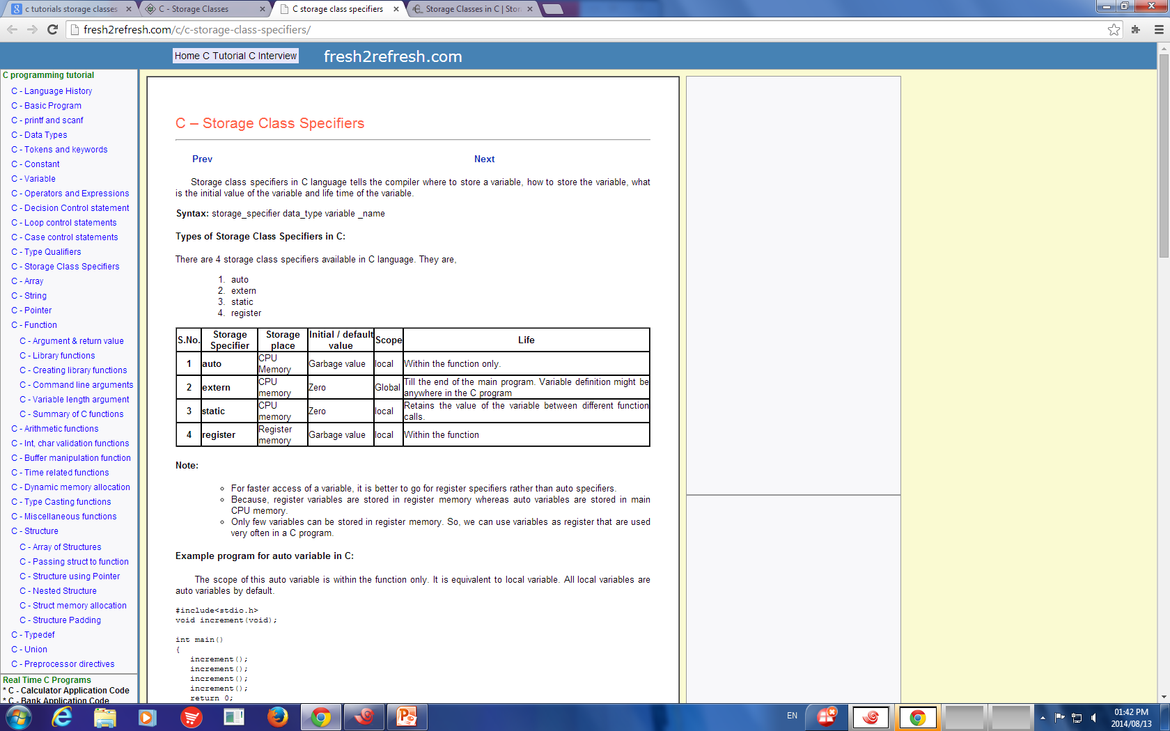
Storage Classes
Defines the scope (visibility) and life-time of variables and/or functions

Slide 4
Example auto
#include <stdio.h>
void increment(int);
int main()
{
auto int count=10 ;
increment(count);
printf("count is %d\n", count);
increment(count);
printf("count is %d\n", count);
increment(count);
printf("count is %d\n", count);
}
void increment(int count)
{
count++;
printf("count is %d\n", count);
}
The scope of this auto variable is within the function only. It is equivalent to local variable. All local variables are auto variables by default.
Life time of auto variable is within the block.
Default value: garbage value

Slide 5
Example static
#include <stdio.h>
void increment(); int main()
{
increment();
increment();
increment();
}
void increment( )
{
static int count=0;
count++;
printf("count is %d\n", count); }
The scope of this auto variable is within the function only.
Life time of static variable until completion of program.
Default value: 0

Slide 6
Example extern
#include<stdio.h>
int x = 10 ;
int main( )
{
extern int y ; //Declaration
printf ( "The value of x is %d\n", x ) ;
printf ( "The value of y is %d\n", y ) ;
return 0;
}
int y = 50 ; //Definition
The scope of this variable is throughout the program
Life time of extern variable until completion of program.
Default value: 0

Slide 7
Example register
#include <stdio.h>
void increment(int); int main()
{
register count = 1;
increment(count);
increment(count);
increment(count);
}
void increment(int count)
{
count++;
printf("count is %d\n", count); }
The scope of this variable is within the block/function
Life time of this variable is within the block/function.
Default value: garbage value
It’s same as auto variable only difference is it’s value stores in registers instead of RAM

Slide 8
Constants

Slide 9
Constants refer to fixed values that the program may not alter during its execution. Constants: integer constant, floating constant, character constant, string constant.
Constants

Slide 10
#include <stdio.h> int main() { int area; const int r = 10 ; const float pi = 3.14; const char nl='\n'; area = 2*pi*r; // pi=pi+0.1; printf("area : %d", area); printf("%c", nl); return 0; }

Slide 11
#include <stdio.h> #define R 10 #define PI 3.14 #define NEWLINE '\n' int main() { int area; area = 2*PI*R; printf("area : %d", area); printf("%c", NEWLINE); return 0; }

Slide 12
Thank You

